Slide 1
Deep Learning Techniques For Breast Cancer Risk Prediction Using Python

Slide 2
Project Description
Breast cancer is one of the main causes of cancer death worldwide. Early diagnostics significantly increases the chances of correct treatment and survival, but this process is tedious and often leads to a disagreement between pathologists.
Computer-aided diagnosis systems showed potential for improving diagnostic accuracy. But early detection and prevention can significantly reduce the chances of death. It is important to detect breast cancer as early as possible.

Slide 3
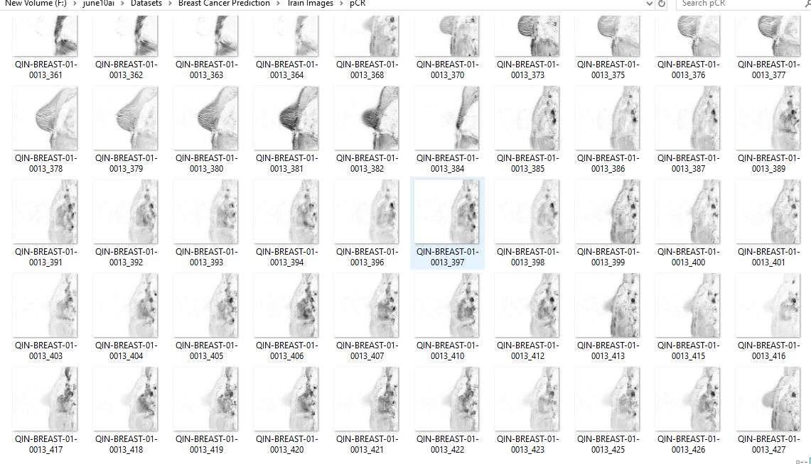
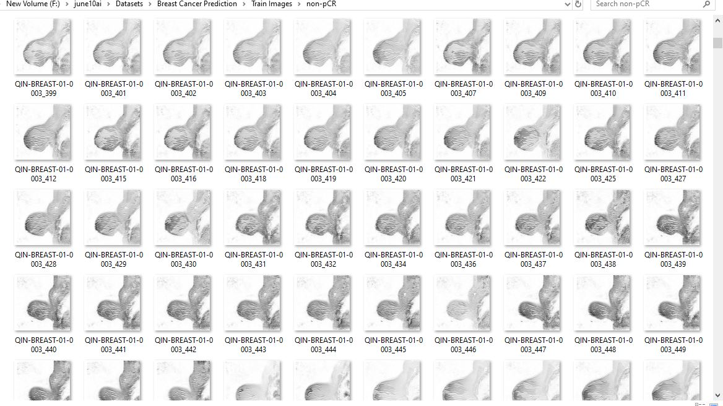
Dataset
This dataset was downloaded from the Kaggle repository : https://www.kaggle.com/shivagayatrianandas/breast-cancer-detection
The dataset contains train and test greyscale scan images.
The prediction is binary as it has either the person has a positive outcome of disease or not with respect to the images.

Slide 4
Algorithm : Convolutional neural network
The convolutional neural network (CNN) is a class of deep learning neural networks. CNNs represent a huge breakthrough in image recognition. They’re most commonly used to analyze visual imagery and are frequently working behind the scenes in image classification
Convolutional layers
ReLU layers
Pooling layers
a Fully connected layer

Slide 5
Steps performed and accuracy:
Datapreprocessing – Anaconda navigator
Model building-Anaconda navigator
Application building- Flask
Accuracy- 60%

Slide 6

User Interface - Flask :

Slide 7
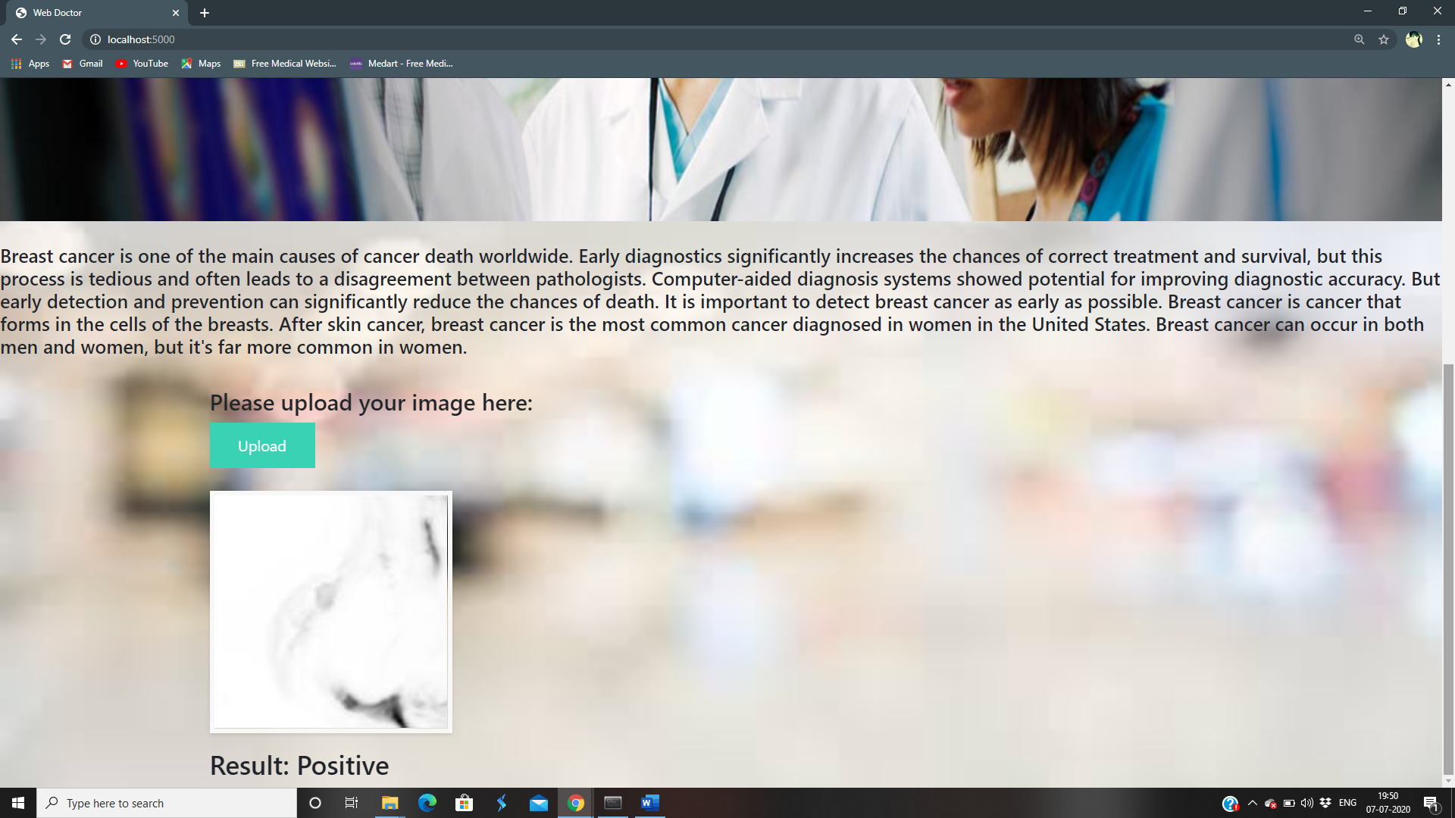

Slide 8
Conclusion :
The final Outcome is where the model predicts the status of the patient as either positive or negative in an interactive UI.
THANK YOU!

Slide 9
Team Members :
Maajidaa begum Z
Mounisha R
Nalapriya D
Raghavarshani K S

